Slide 1

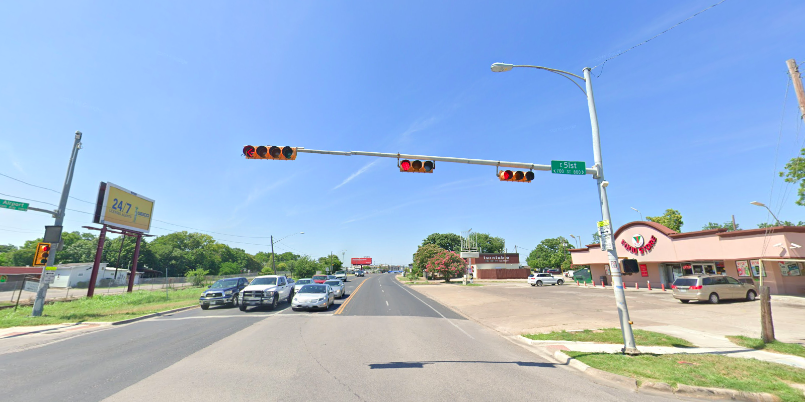
Austin Transportation Department Signs Work Orders
Created By: Susanne Gov Created Date: 2020-08-10 Location Name: AIRPORT BLVD / 51ST ST Intersection ID: 5160367 Cardinal Direction: N
Sign Type | Install/Remove
Street Name Sign | Install
School Zone | Install
Cell Phone Use Prohibited | Install

Slide 2
Austin Transportation Department Signs Work Orders
Created By: Susanne Gov Created Date: 2020-08-10 Location Name: AIRPORT BLVD / 51ST ST Intersection ID: 5160367 Cardinal Direction: S
Sign Type | Install/Remove
Street Name Sign | Install
School Zone | Install
Cell Phone Use Prohibited | Install

Slide 3
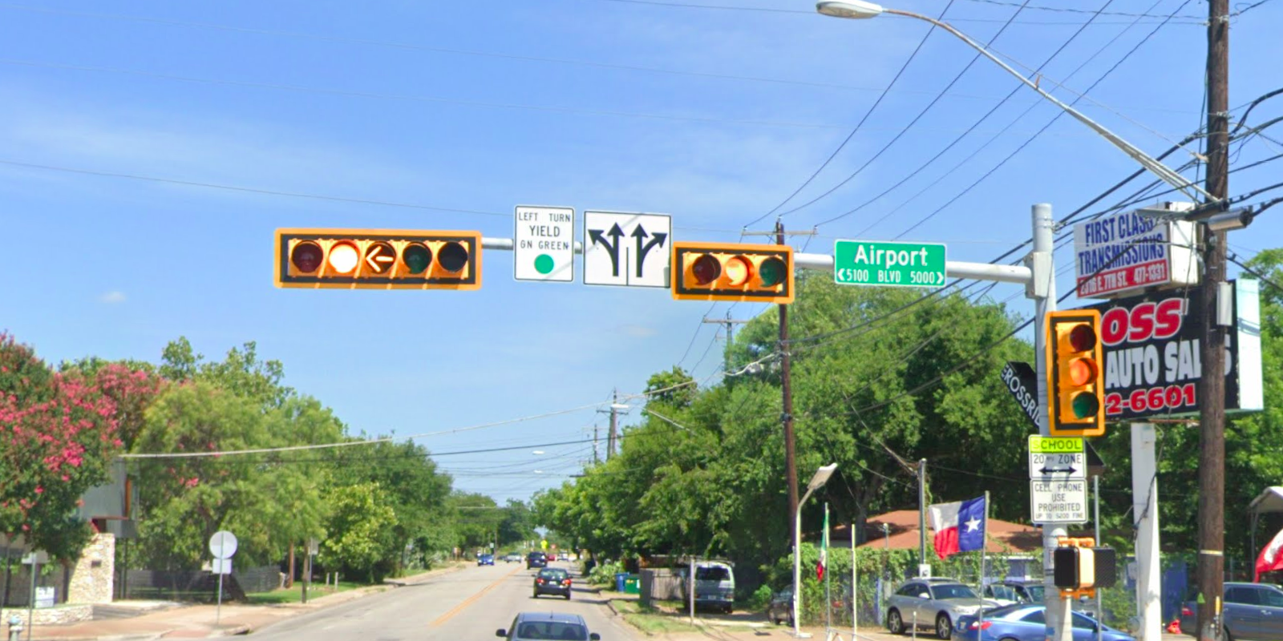
Austin Transportation Department Signs Work Orders
Created By: Susanne Gov Created Date: 2020-08-10 Location Name: AIRPORT BLVD / 51ST ST Intersection ID: 5160367 Cardinal Direction: E
Sign Type | Install/Remove
Left Turn Yield On Green | Install
Street Name Sign | Install
Straight Right Arrow | Install
School Zone | Install
Cell Phone Use Prohibited | Install

Slide 4
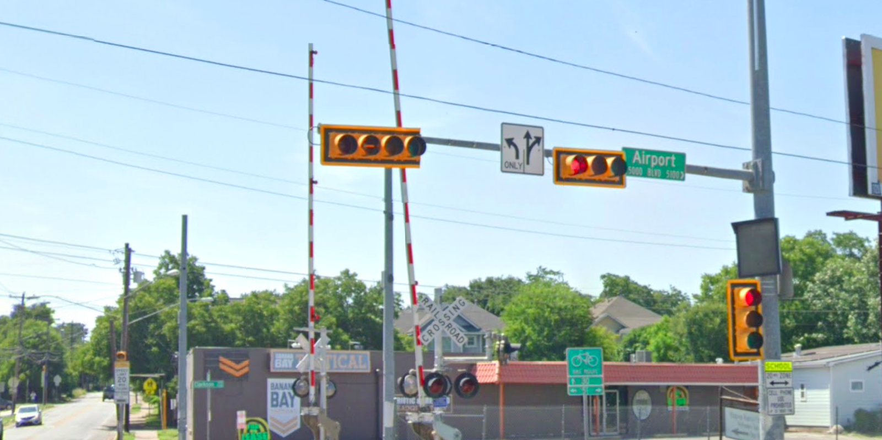
Austin Transportation Department Signs Work Orders
Created By: Susanne Gov Created Date: 2020-08-10 Location Name: AIRPORT BLVD / 51ST ST Intersection ID: 5160367 Cardinal Direction: W
Sign Type | Install/Remove
Left Turn Arrow Only | Install
Street Name Sign | Install
Straight Right Arrow | Install

